Slide 1
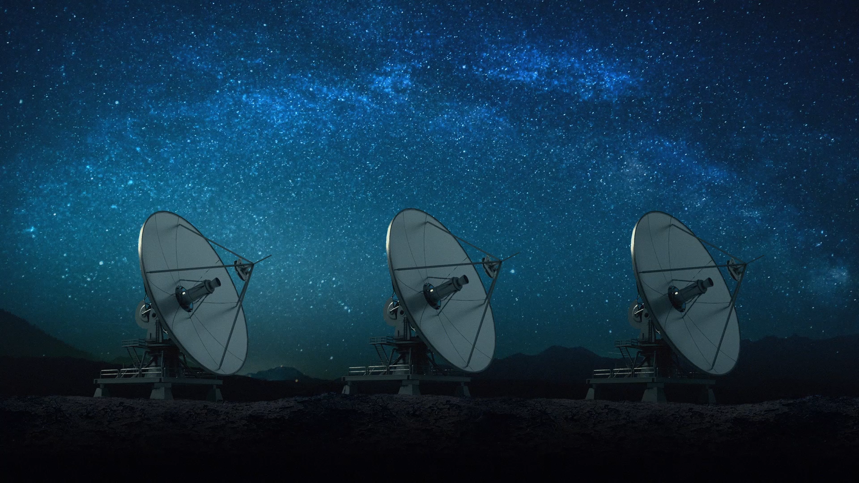
Radiation Quantities and Units
Course Name: Radiation Safety (SEC)
Code:PHYS307TH

Slide 2
Contents:
Types of Radiations
Different Units of activity
KERMA
Natural Sources of Radiations
Artificial Sources of Radiations
Radiation Dose

Slide 3
Types of Radiations:
Ionizing Radiations (X- rays, γ- rays, α- rays,β-rays, protons)
Non-ionizing Radiations(U V rays, visible light ,I R rays ,microwave radiations and radiofrequency radiations)

Slide 4
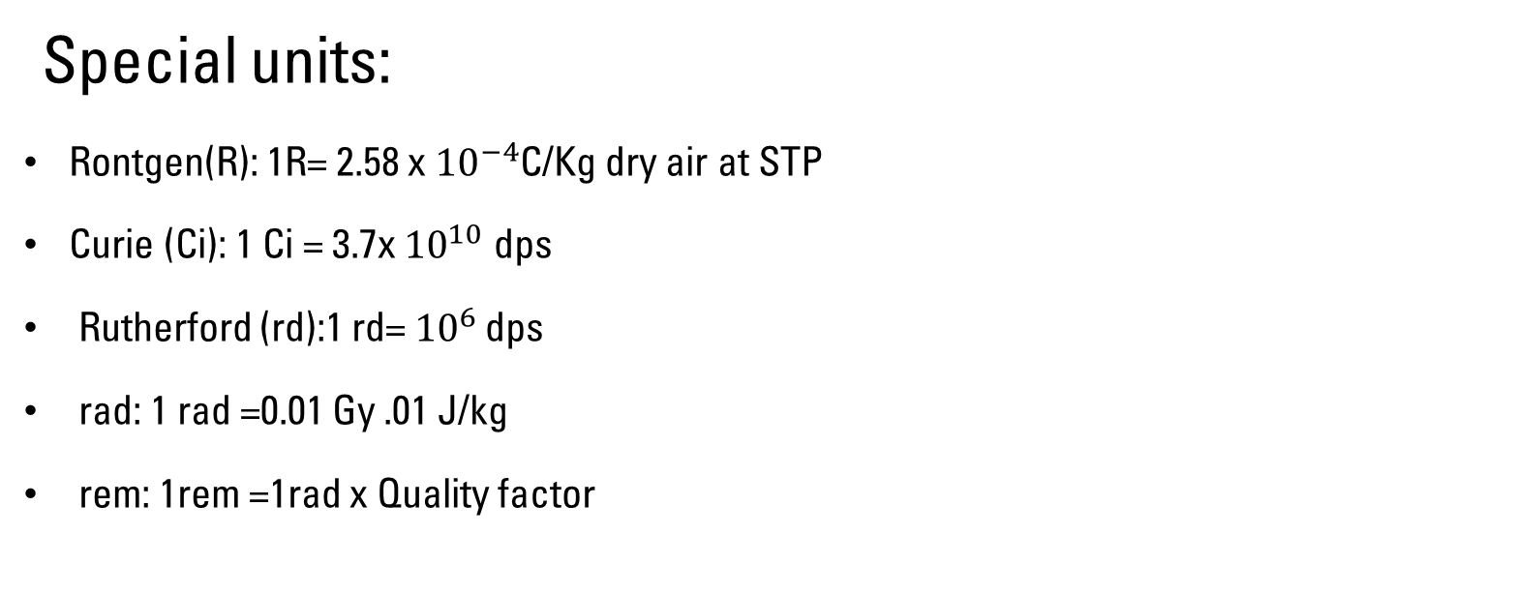
Different Units of Activity:
Special units:
Rontgen(R): 1R= 2.58 x ${10}^{−4}$C/Kg dry air at STP
Curie (Ci): 1 Ci = 3.7x ${10}^{10}$ dps
Rutherford (rd):1 rd= ${10}^{6 }$dps
rad: 1 rad =0.01 Gy .01 J/kg
rem: 1rem =1rad x Quality factor

Slide 5
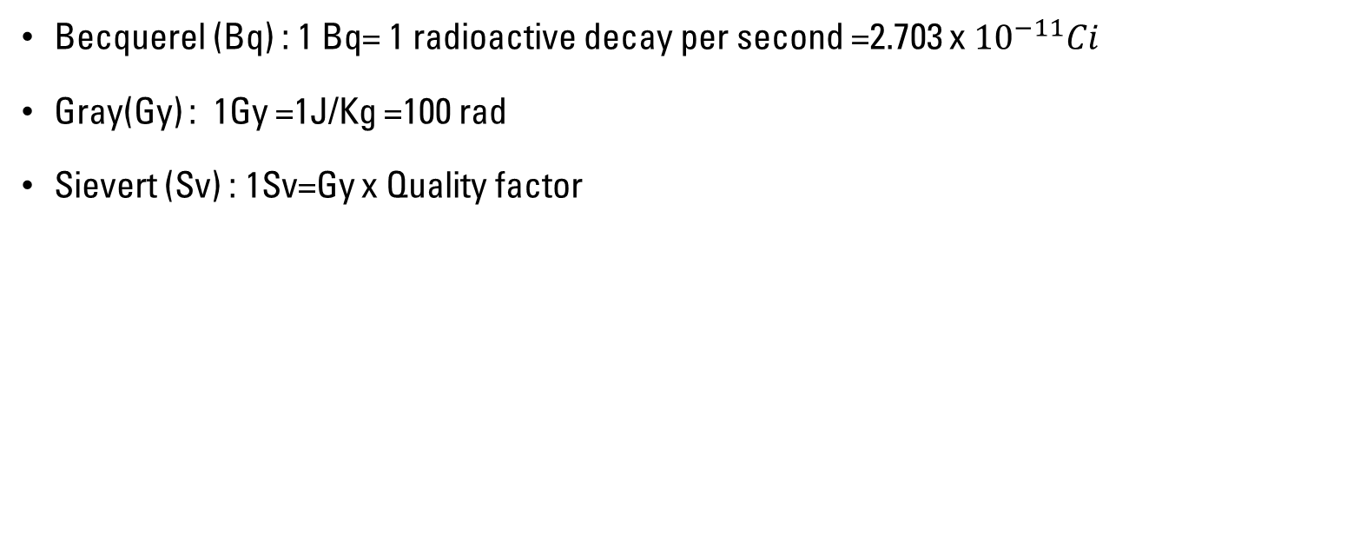
S I Units:
Becquerel (Bq) : 1 Bq= 1 radioactive decay per second =2.703 x ${10}^{−11}Ci$
Gray(Gy) : 1Gy =1J/Kg =100 rad
Sievert (Sv) : 1Sv=Gy x Quality factor

Slide 6
KERMA:
Kinetic Energy Released per unit Mass
Measure of energy transferred from radiation to matter
Measure of amount of radiation energy in joules absorbed in unit mass (kg) of air
KERMA is expressed in J/Kg i.e. gray (Gy)
SI unit of KERMA is gray and 1 Gy =1J/Kg

Slide 7
Natural Sources of Radiations:
Exposure from cosmic radiations
Exposure through inhalation
Exposure through ingestion
Exposure through terrestrial radiation
Natural radioisotopes

Slide 8
Artificial sources of radiations:
Atmospheric testing
Medical sources
Industrial Sources
Nuclear Fuel Cycle

Slide 9
Radiation Dose:
Absorbed Dose:
Also known as physical Dose
Amount of energy deposited by radiation in a mass
Unit of absorbed dose is milligrays (mGy)
Equivalent Dose:
Called as Biological dose
Product of average absorbed dose in an organ and radiation weighing factor
Unit of equivalent dose is sievert (Sv)
Effective Dose:
Called whole body dose
Sum of the weighted equivalent doses in all the tissues and organs of the body
Unit of effective dose is mSv

